Slide 1
Ethical Hacking Project Task 3
Present By Akshay Patel

Slide 2
Content
Report
Poc video
Screenshot

Slide 3
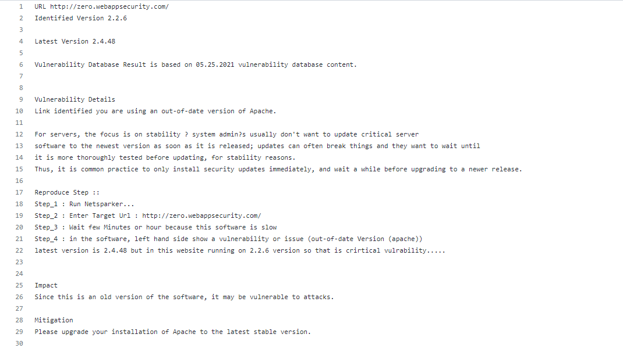
Report
My Project report see on my github repository
LINK
: https://github.com/jackyvirus/Ethical_Hacking_Project-Internship_Studio-/blob/main/report

Slide 4
POC Video
Watch On My GitHub Repository

Slide 5
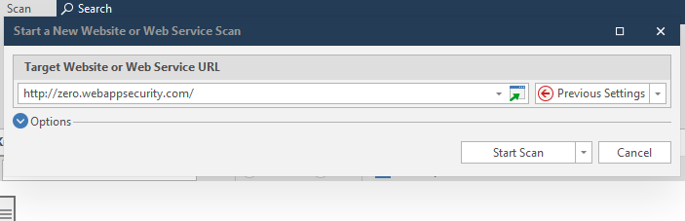
SreenShot

Slide 6
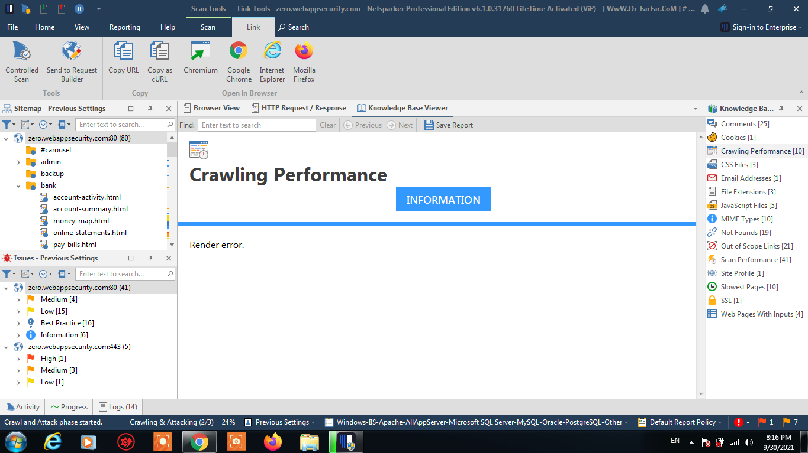

Slide 7
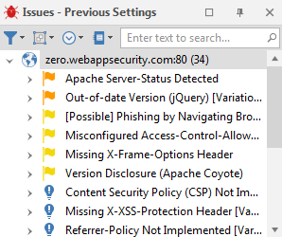
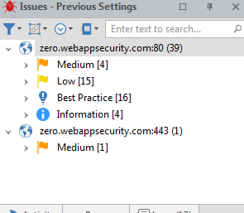
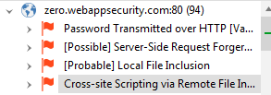

Slide 8
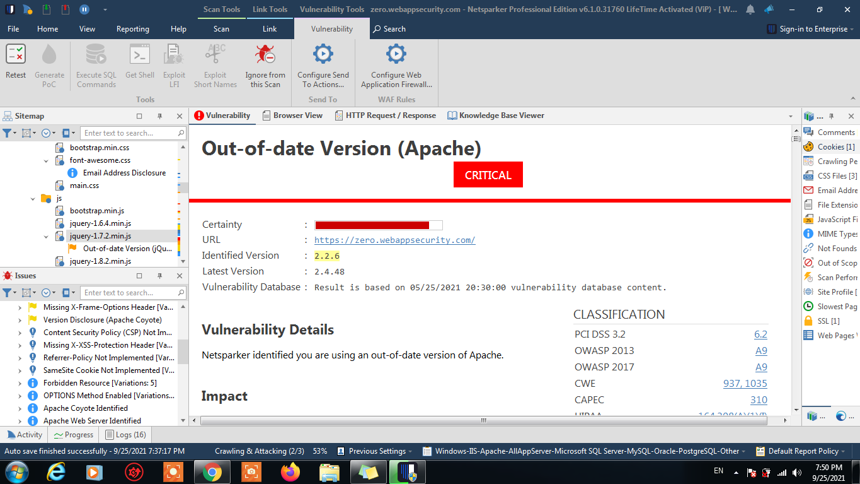

Slide 9
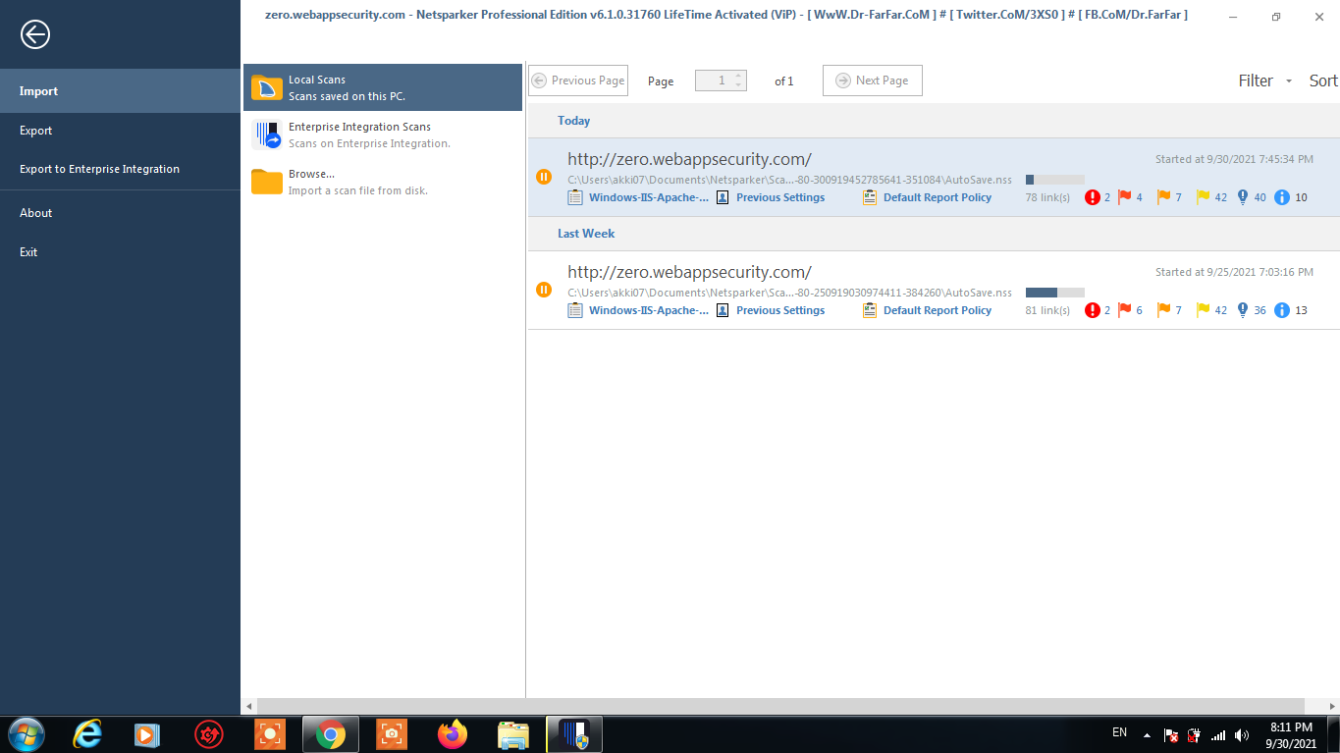

Slide 10
THANK YOU

